Slide 1

Multiple Linear Regression ML Model For NBA Players’ Net Ratings

Slide 2
Introduction And Motivation:
In the National Basketball Association (NBA) league, team management is crucial in many aspects, including draft picks, trades, and contract negotiations, partly because of the NBA's trade rules and salary cap.
Each team willing to sign the best players to achieve its goals, in accordance with the NBA's trade rules and salary cap.
One of the most important aspects of determining a player’s value is his Net Rating, which can be explained simply as how much better or worse the team performs when that player is on the court.
The goal of this project is to build a Machine Learning multiple regression model using Python, that will consider certain aspects of a player and team to determine his expected Net Rating.
As a result, teams' managers could anticipate the Net Rating of a player and evaluate his performance based on team performance, and thus make better data-driven decisions that will contribute to their team's success.

Slide 3

Data Description:
The data was directly collected by making an API call to stats.nba.com using a custom Python script. All the data is fully attributed to NBA.com.
The data is taken from: https://www.kaggle.com/justinas/nba-players-data.
Each row of the data set represents a player's statistics in a specific season for the last team he played for in this season.
The data contains 11,145 rows and 22 columns of player's statistics between the seasons 1996-1997 to 2019-2020. The data from season 2019-2020 is incomplete so I have not analyzed it.

Slide 4

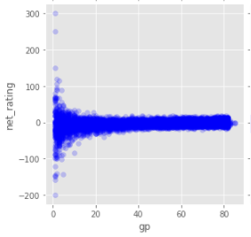
Data Cleaning
Due to extreme values that create outliers in the season statistic of players who played less than 12 games in the season, I analyzed only statistics of players who played more than 11 games in the season.
Players' Net Rating By Number Of Games Played In A Season:
The rows with a draft year of NULL or 'Undrafted' have been removed because the multiple linear regression model will only check the players that were drafted to prevent extreme results and to examine the effect of the draft pick number on the player’s Net Rating.

Slide 5
ETL Process
To extract data, transform it, and load this data to my data frame, I accessed tables containing data about teams' conferences (west vs. east), their ranking in the regular season, and players' positions.
Based on it I added Team Rank In Regular Season, Conference, and Position columns to the data frame.

Slide 6
Feature Engineering
In the table, I created columns to indicate by 1 or 0 values whether the player is American, if he is playing in the West conference and his position.
For the Seniority By Years column, I calculated how many seasons a player had played until the relevant season.
In order to determine the player's expected Net Rating, I created columns with statistics from the previous year. I then used these columns to create a multiple regression model. The following statistics from the previous year have been added: Team Rank, Points, Net Rating Rebounds, True Percent Shooting, and Assists Percent.

Slide 7
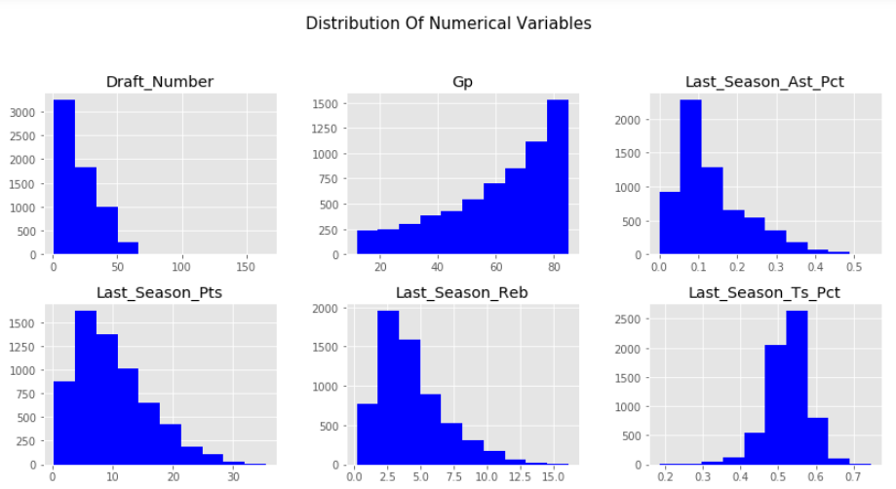
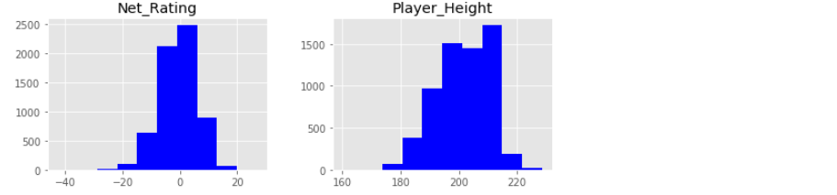
Data Exploration

Slide 8
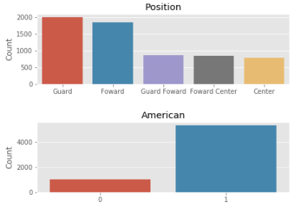
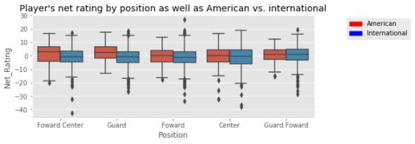
Data Exploration
Distribution Of Players By Position And Nationality, Based On Number Of Seasons Played:

Slide 9
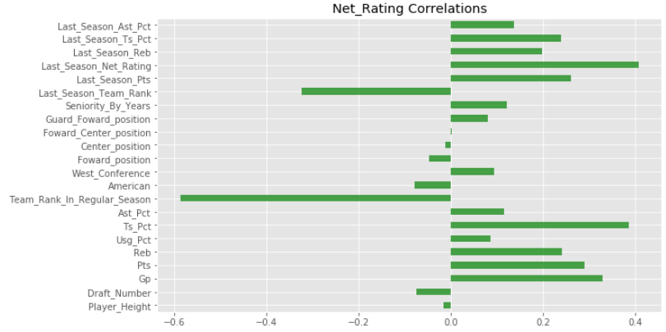
Data Explanation

Slide 10
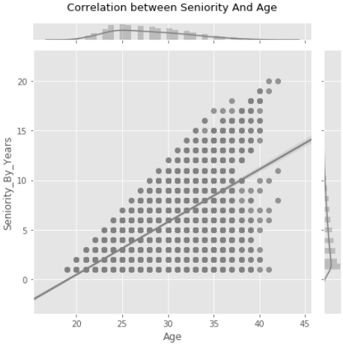
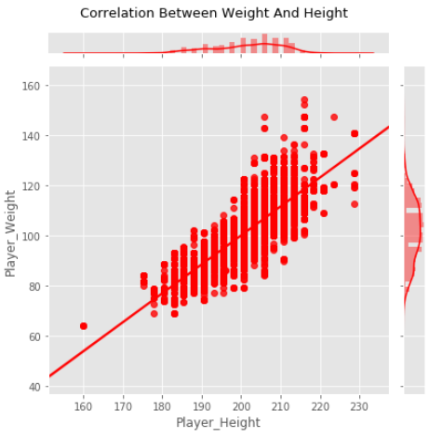
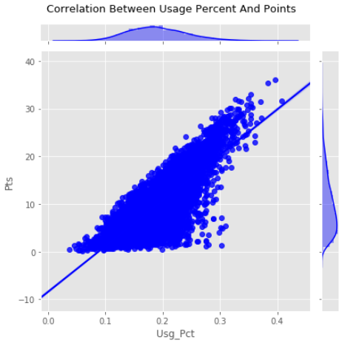
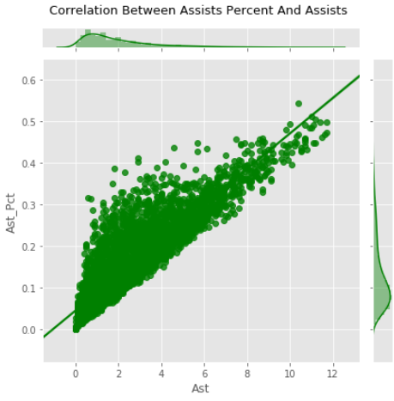
Variables with high correlations that may imply multicollinearity
Some variables have high correlation that may imply multicollinearity.
I used heatmap and then scatter plot to detect pairs variables with high correlation.
There is also a high correlation between offensive/defensive rebound percent and rebounds, as well as last year's points and points, and so on.
I used Seniority, Height, and Last Year Rebounds, Assist Percentage, and Points per Game from last season to build the model.

Slide 11
Model building and evaluation:
I built a machine learning multiple linear regression model.
After built the model I evaluated it and found out that some variables P-Value were higher than 0.05 so they are insignificant in 95% confidence interval, therefore, I removed them from the model.
The R-Squared value of the model fall from about 45.6% to about 42.3%.
The average distance between the predicted Net Rating and the actual Net Rating is about 4.8, while the standard error of the Net Rating is about 6.7.

Slide 12
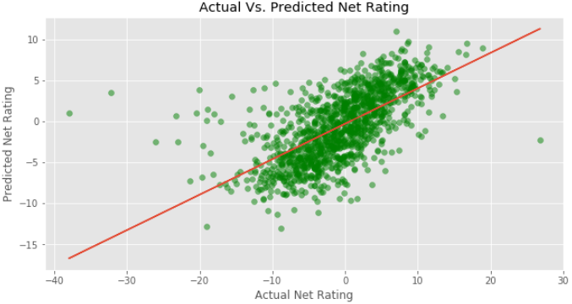
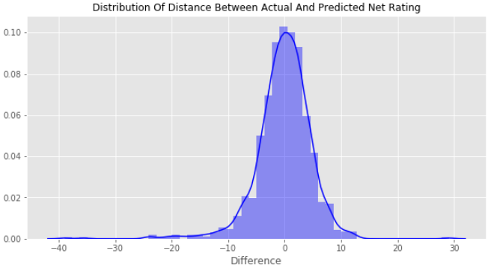
Model Evaluation:
The model can be further improved as shown in the above figures.
By adding more relevant data to the model, such as: Team Net Rating, playoff statistics, contract value, statistics about the rank of the team the player played against, etc., the model can be improved.

Slide 13
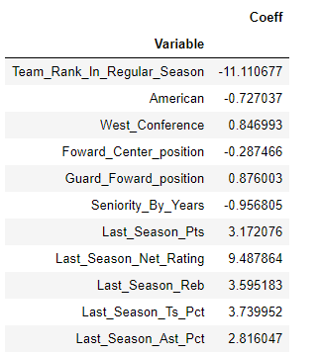
Model Evaluation:
On the right you can see the Coeff (coefficient) of the variables - meaning that for every unit added to that variable, the Net Rating will increase / decrease by the value on the right of the variable.
As the constant value is not significant, it is unknown what the player's Net Rating will be if all the variables are 0. This makes complete sense.

Slide 14
Insights:
Team Rank has a very negative effect on the player's Net Rating, so if the player plays in a good team, probably his Net Rating will be higher.
We can see that good player’s statistics in the last season probably means that he is going to have a good Net Rating in the current season.
We can see that a team from the west conference should expect their players to have a higher Net Rating due to the dominance of the west teams over the east teams between 1996-1997 and 2018-2019.

